Slide 1





Challenges and Innovation in Civil and Environmental Engineering
Phytotechnology in the Present and Future: Remedies for Contaminated Soil and Water
Alain Manceau
http://isterre.fr/alain-manceau
Seminar given at the University of Notre Dame in the Department of Civil & Environmental Engineering & Earth Sciences on the invitation of Dr. Patricia A. Maurice - April 18, 2013
Notes:
The term “phytotechnology” refers to scientific and engineering solutions involving plants and associated miroorganisms to clean and protect environmental matter contaminated by trace elements (TEs), typically metals (TMs), metalloids, radionuclides, and/or organic xenobiotics (OX).

Slide 2
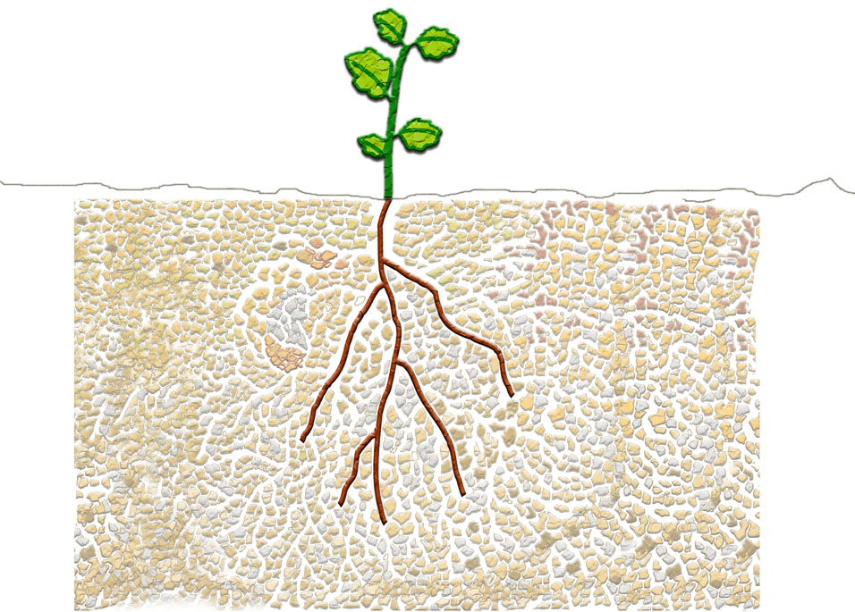
Introduction
Rhizosphere
Absorption
K, nitrate, phosphate
Bulk soil
Secretion
H⁺/OH⁻
Organics
CO₂
Respiration
O₂
Notes:
At the heart of phytotechnology is the rhizosphere which is the interface between the contaminated compartment and the “cleaning factory”, which is the plant. The rhizosphere is the narrow region of soil that is directly influenced by root secretions and associated soil microorganisms. Soil which is not part of the rhizosphere is known as bulk soil. Plants secrete many compounds into the rhizosphere which serve different functions (sugars, proteins).

Slide 3
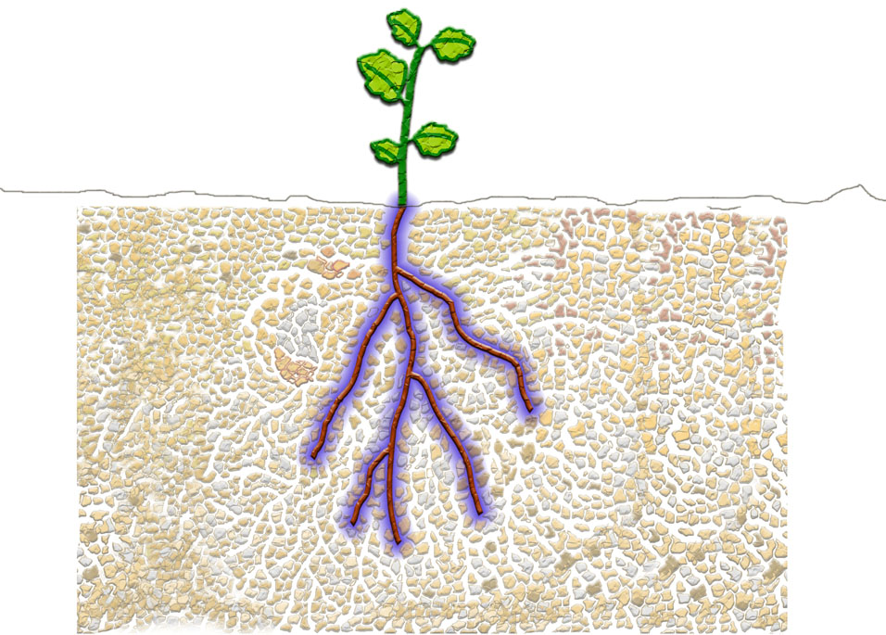
Introduction
Rhizosphere
Absorption
K, nitrate, phosphate
Bulk soil
Secretion
H⁺/OH⁻
Organics
CO₂
Respiration
O₂

Slide 4
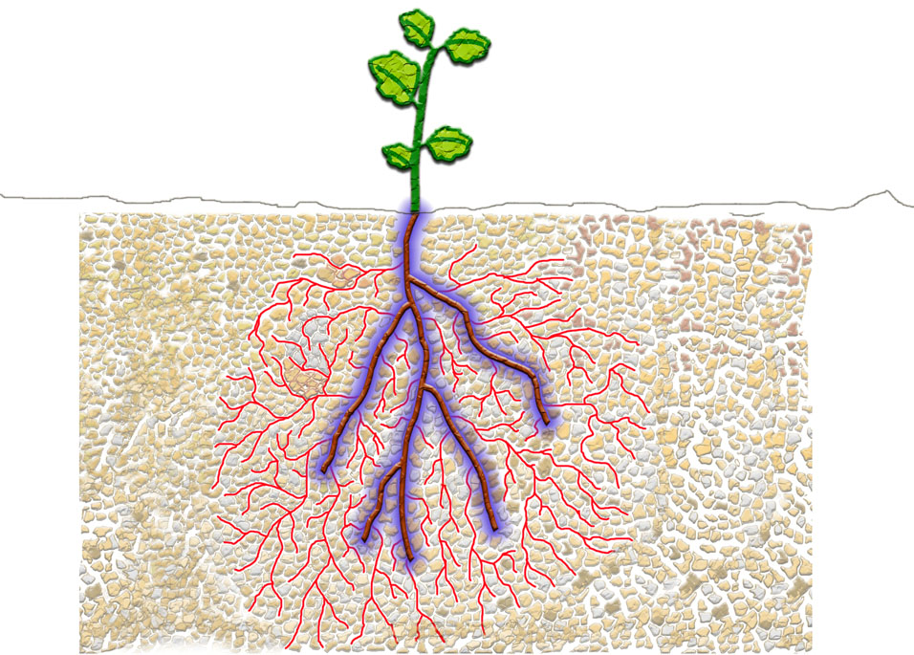
Introduction
Rhizosphere
Absorption
K, nitrate, phosphate
Bulk soil
Secretion
H⁺/OH⁻
Organics
CO₂
Respiration
O₂
Notes:
Most plants live in symbiosis with fungal myccorhizae, which extend the influence volume of the plant activity.

Slide 5
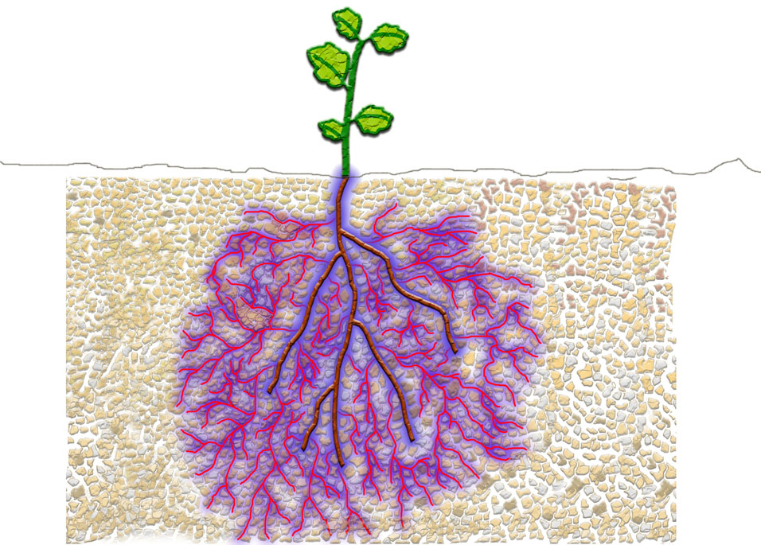
Introduction
Mycorhizosphere
Absorption
K, nitrate, phosphate
Bulk soil
Secretion
H⁺/OH⁻
Organics
CO₂
Respiration
O₂

Slide 6
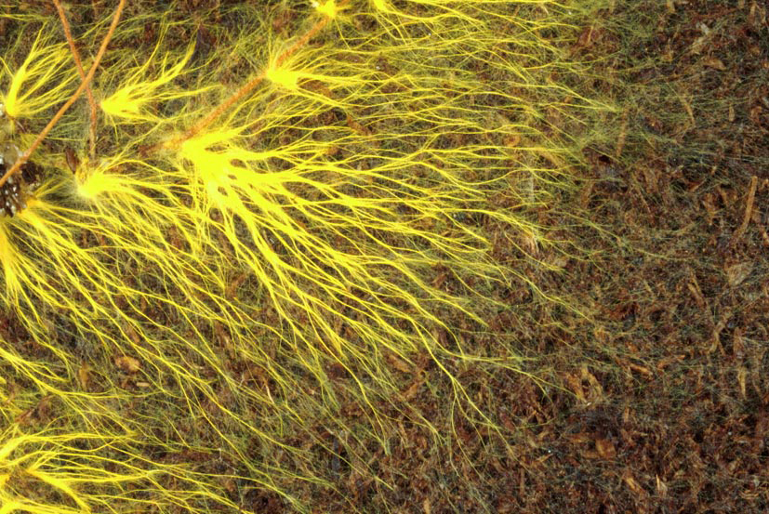
Introduction
Notes:
Example of mycorrhiza

Slide 7
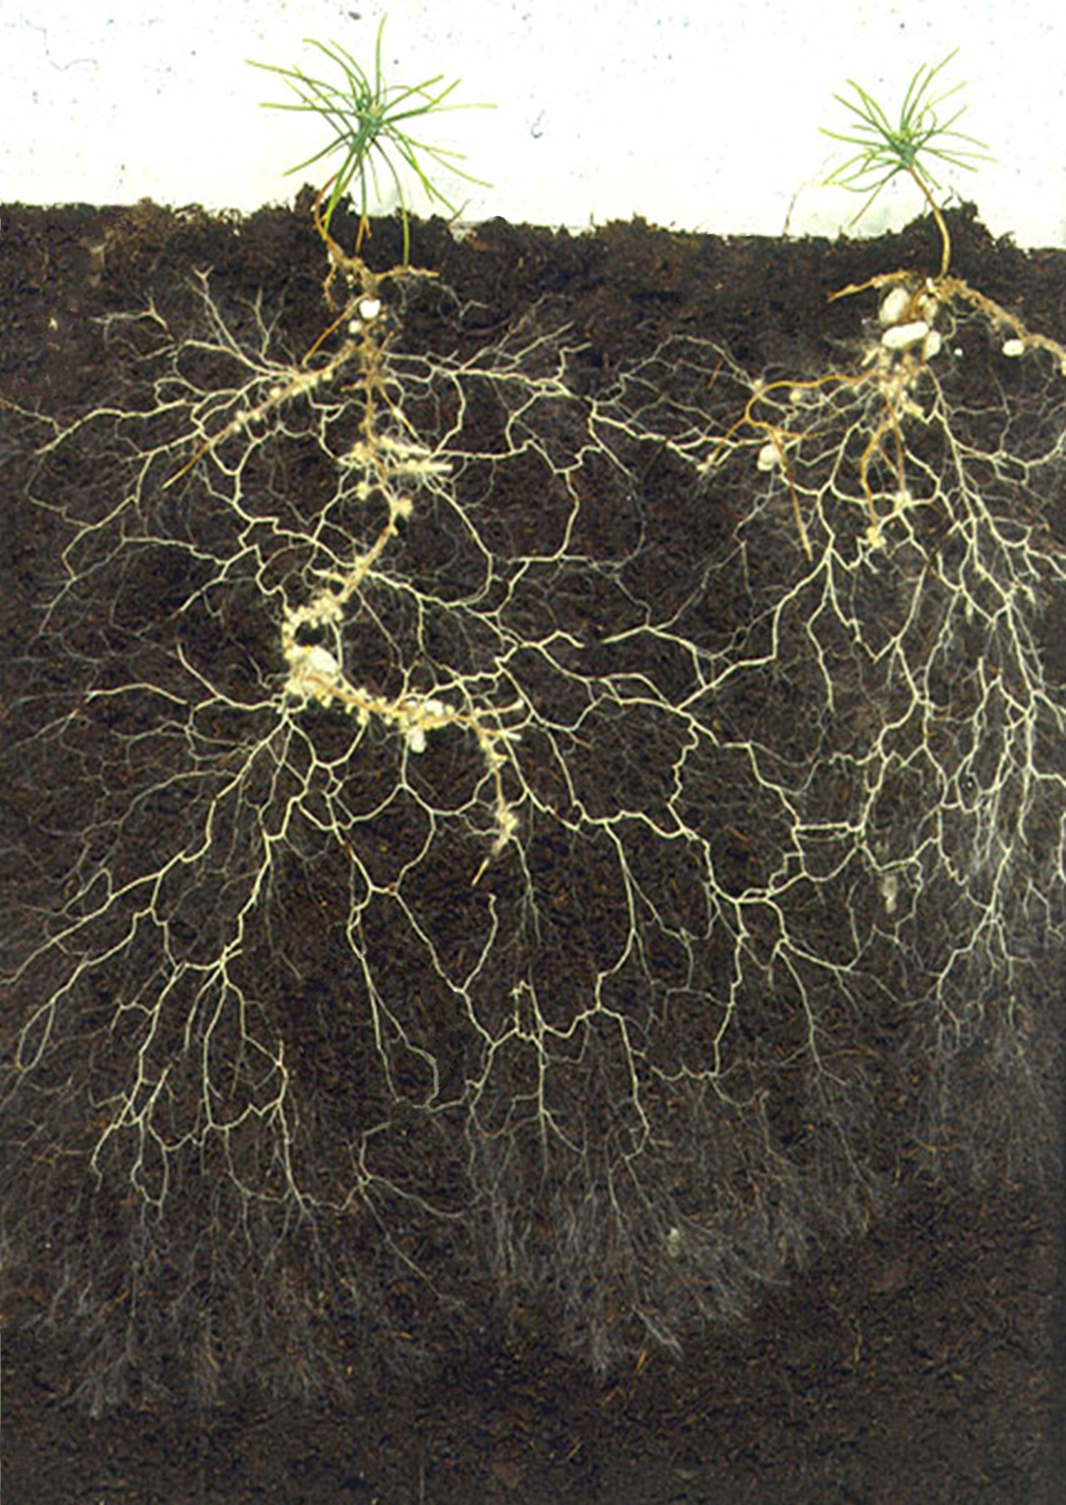
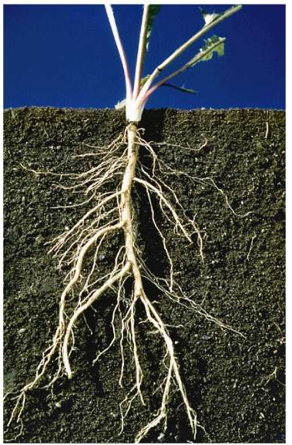
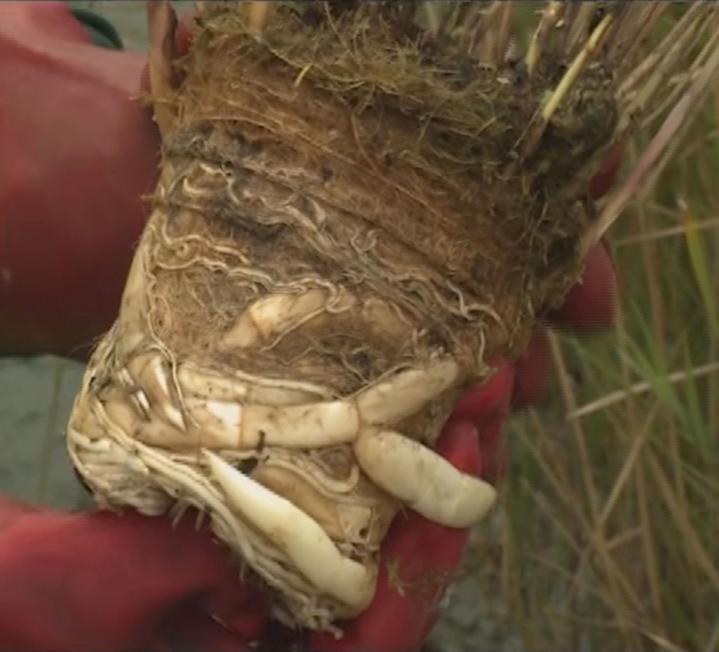
Introduction
Phragmites australis
(common reed)
Notes:
P. Australis is a large perennial grass found in wetlands throughout temperate and tropical regions. It is one of the main wetland plant species used in phytoremediation. The soil matrix can be totally « rhizospheric ».

Slide 8
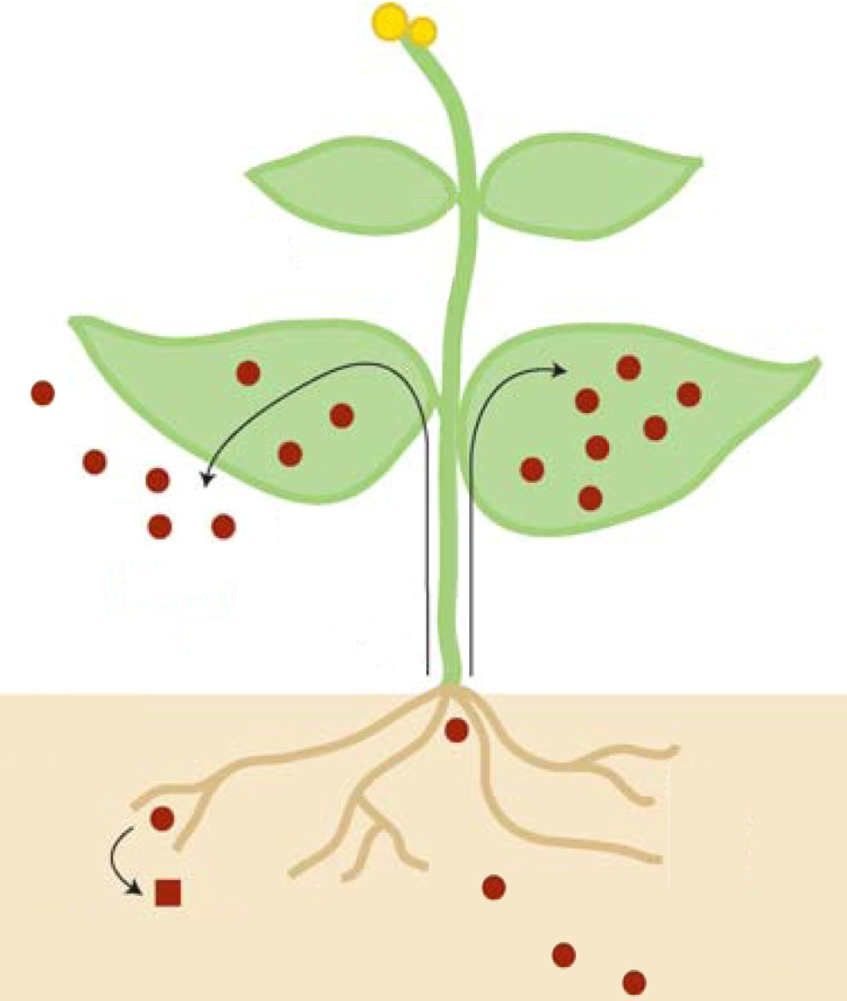
Phytotechnologies
Cross-disciplinary field:
Agronomy
Soil science
Bio(geo)chemistry
Environmental mineralogy
Plant biology
Plant genetics
  Phytoextraction
  Phytovolatilization
  Phytostabilization
  Rhizofiltration
  Phytolixiviation
Pilon-Smits, Ann. Rev. Plant Biol., 2005.

Slide 9
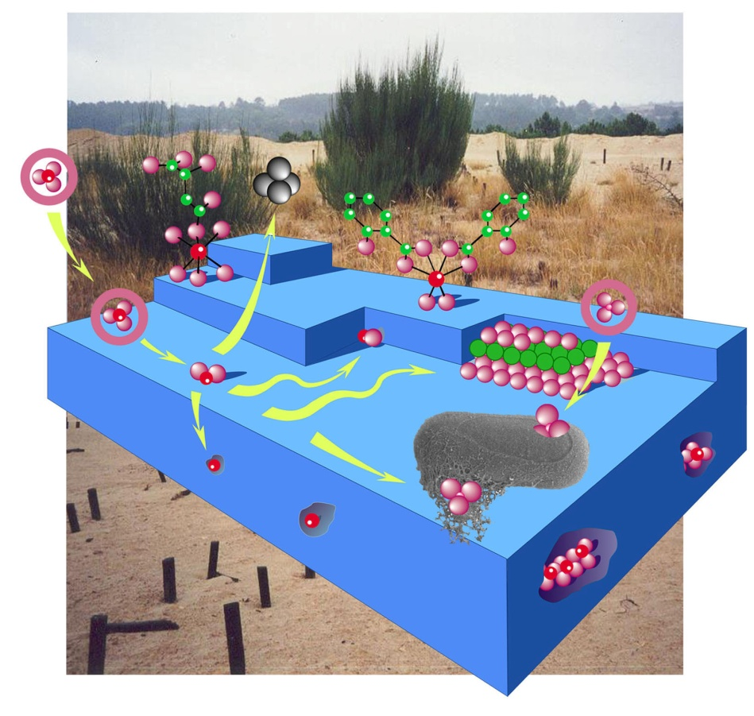
Phytostabilization
Solubility ↔ Bio-disponibility ↔ Toxicity
Principle :
Involves the reduction of the mobility of trace metals (TMs) in soil with amendments to minimize TMs transfer to the food chain and leaching to goundwater. In situ treatment.
Phosphate added to lead-contaminated soil
Mineral
Solubility (log Ksp)
Anglésite - PbSO₄
Cerrusite - PbCO₃
Galène - PbS
Fluoropyromorphite - Pb₅(PO₄)₃F
Hydroxypyromorphite - Pb₅(PO₄)₃OH
Chloropyromorphite - Pb₅(PO₄)₃Cl
Hinsdalite - PbAl₃(PO₄)(OH)₆SO₄
Plumbogummite - PbAl₃(PO₄)₂(OH)₅H₂O
Corkite - PbFe₃(PO₄)(OH)₆SO₄
-7.8
-12.8
-27.5
-76.8
-82.3
-84.4
-99.1
-99.3
-112.6
Notes:
This phytotechnology works pretty well for Pb owing to the low solubility of lead phosphates, and also for Cr (reduction of mobile Cr(VI) to immobile Cr(III)) and for radionuclides.

Slide 10

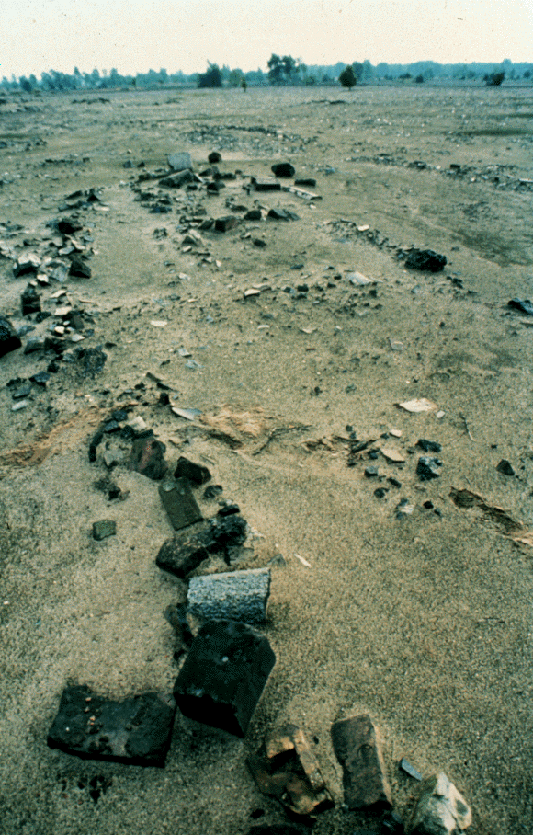
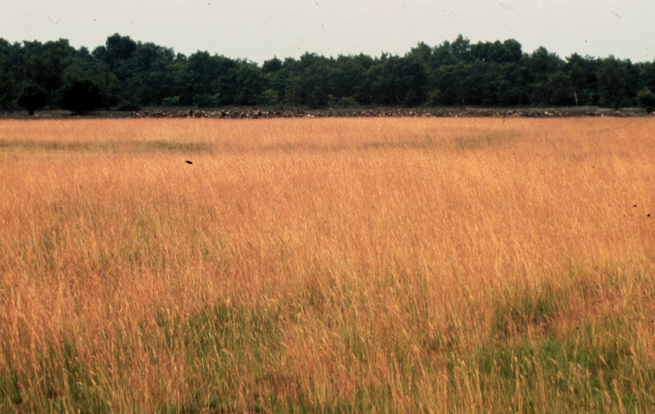

Phytostabilization
Application :
(Re)-vegetation of large-scale areas (barren land, mine spoils, abandoned smelter…).
Contamination source: Zn smelter
Before…
Zn, Cd, Pb
Festuca rubra
Agrostis capillaris
After phytostabilization
[Zn] = 3%
TMs are still present, but immobile, allowing the reinstallation of a vegetation cover and the further development of crops.
Vangronsveld et al., Environ. Pollution, 1995.
TMs are mobile, hence phytotoxic.
Site: Lommel, Belgium.
Notes:
This technique can be used to create an ecosystem of indigenous flora and fauna, thus restoring the ecological value of the site.

Slide 11
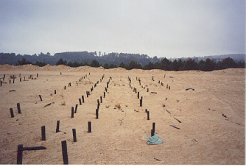

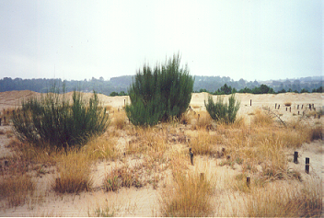

Phytostabilization
Application :
(Re)-vegetation of large-scale areas (barren land, mine spoils, abandoned smelter…).
Contamination source: Au mine
Before…
After phytostabilization
[As] = 0.13%
Revegetation the 1st yr. with Holcus lanatus and the 2nd yr. with Pinus pinaster after in situ As inactivation by the co-amendment of zerovalent Fe, coal fly ash, and compost.
Mench et al., Plant & Soil, 2003.

Slide 12
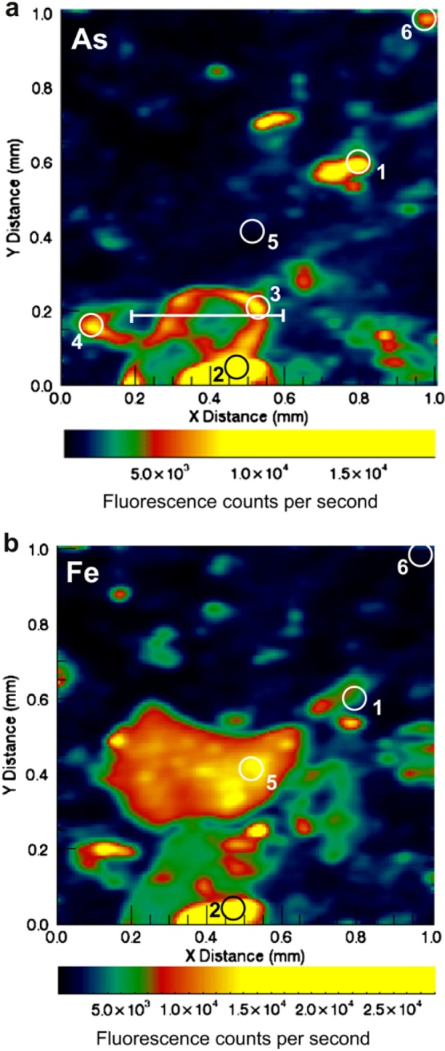
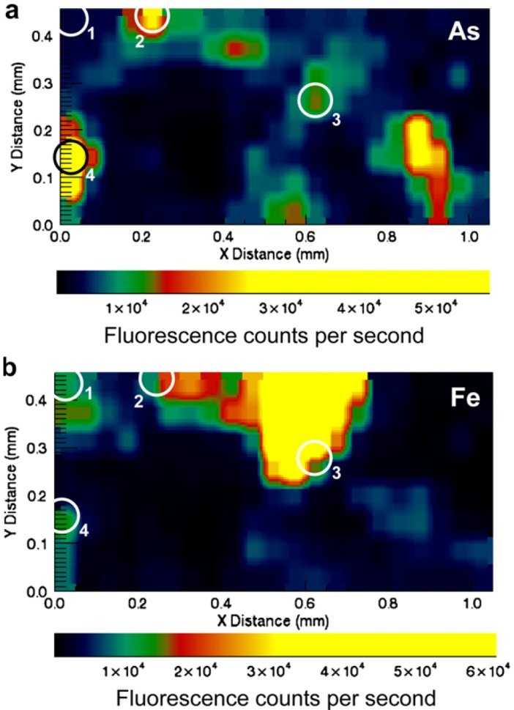
Phytostabilization
Mechanism
After phytostabilization
As binding to poorly crystalline Fe oxyhydroxides
Method: Micro X-ray fluorescence
Before…
Kumpiene et al., Environ. Pollution, 2012.
Notes:
As is preferentially associated with poorly crystalline Fe-oxyhydroxides as opposed to crystalline Fe-(oxyhydr)oxide phases. Correlation maps of As:Fe reveal that As in the treated spoils is primarily contained in surface coatings as precipitates and sorbates. Arsenic binding with poorly crystalline Fe-oxyhydroxides diminishes its mobility. As speciation can be further characterized using micro-XRD and micro-EXAFS. One detailed example is shown below with Zn and Cu.

Slide 13
Phytostabilization
Benefits:
Phytostabilization is a mature and cost efficient method when compared to other technologies.
Cons:
Not applicable to TMs readily translocated to leaves due to potential effects to the food chain.
  Phytoextraction
  Phytovolatilization
  Phytostabilization
  Rhizofiltration
  Phytolixiviation
Notes:
Benefits: Phytostabilization is less disruptive and expensive than excavation, and is environmentally friendly. Metals are not « removed », the contamination has been mitigated.

Slide 14
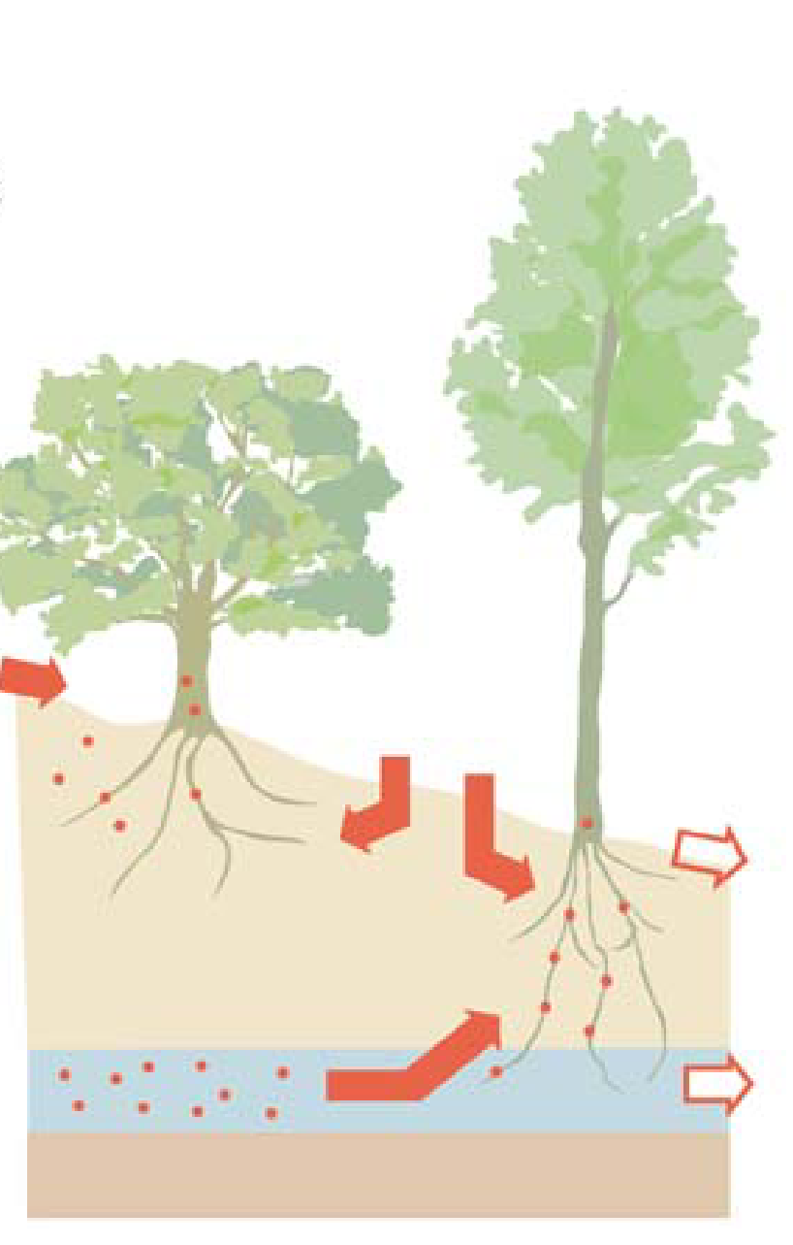
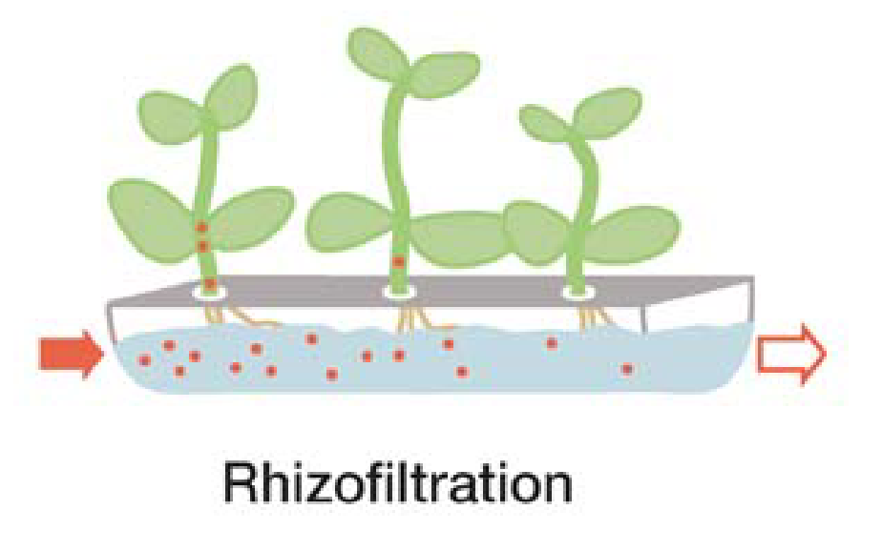
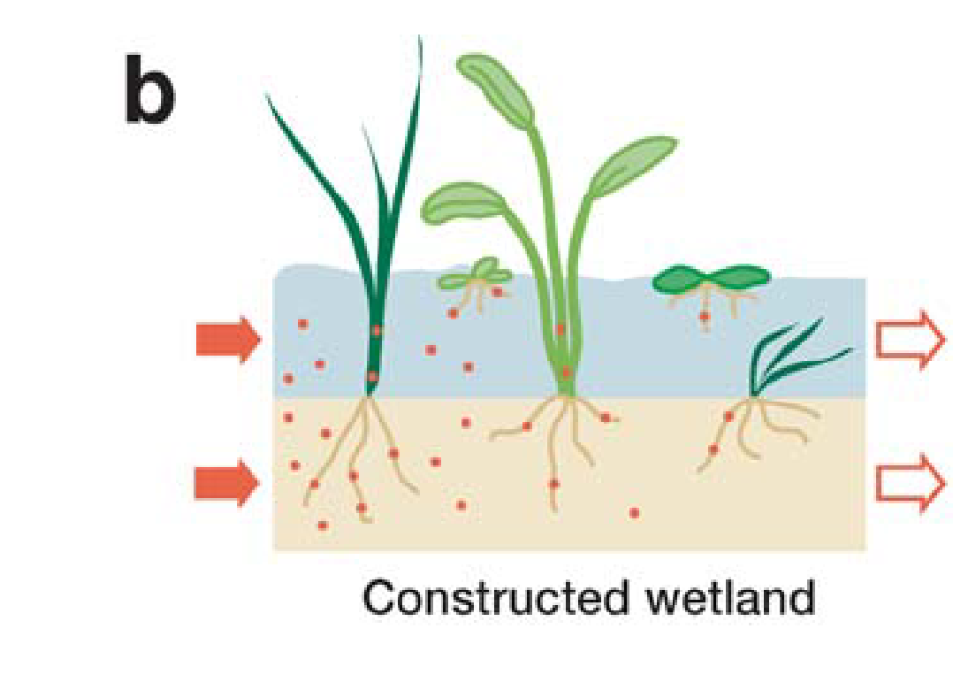
Rhizofiltration
Principle :
Refers to the use of plant roots to absorb, concentrate, and precipitate toxic metals from flowing water. In situ treatment.
Application :
Industrial wastewaters, surface runoffs from mines, groundwaters…
Pilon-Smits, Ann. Rev. Plant Biol., 2005.

Slide 15
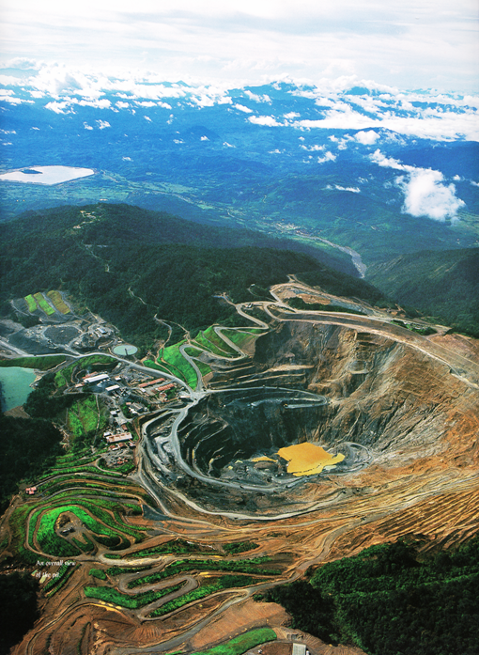
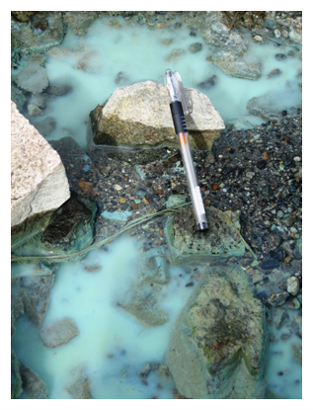
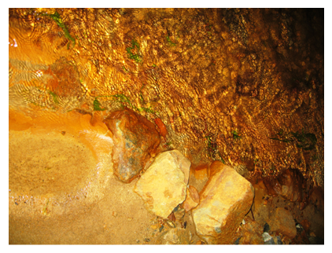
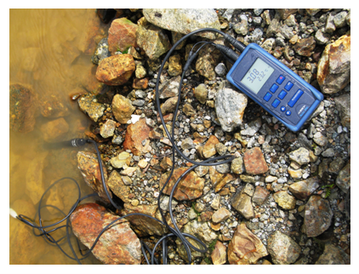
Rhizofiltration
Example :
Acid mine drainage (AMD)
Ore = CuFeS₂
(chalcopyrite)
CuSO₄.n(H₂O)
Mamut mine, Malaysia
Oxidation of pyrite
2 FeS_{2 (s)} + 7 O₂ + 2 H₂O → 2 Fe²⁺ + 4 SO₄²⁻ + 4 H⁺ (1)
Fe²⁺ + ¼ O₂ + H⁺ → Fe³⁺ + ½ H₂O (2)
Fe³⁺ + 3H₂O → Fe(OH)₃ + 3H⁺ (3)
pH 3.08
Notes:
Coal also contains pyrite. About half of the coal mine discharges in Pennsylvania have pH under 5.

Slide 16
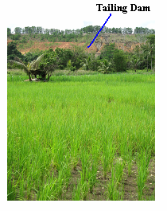
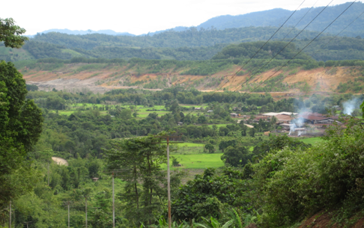
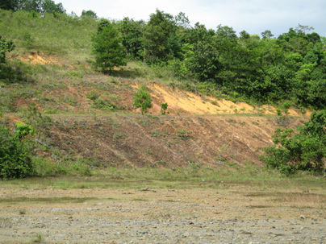
Rhizofiltration
Example… to not follow
Slag heap
Slag heap
6.5 Mt/yr => 160 Mt total
Notes:
Paddy fields are heavily contaminated by Cu leached from the mine spoil. Solution => Belt of constructed wetland, semi-natural marsh or swamp to contain contaminants. Wetland sediments are generally anaerobic below a thin oxidized surface layer and contain organic carbon for microbial growth. The anoxic zone of the sediments provide conditions which favor microbial and chemical reducing processes, transforming iron and sulfates to hydrogen and sulfides (=> immobilization of TMs)

Slide 17
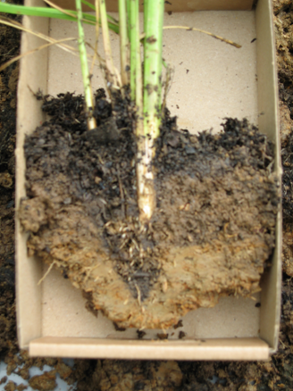
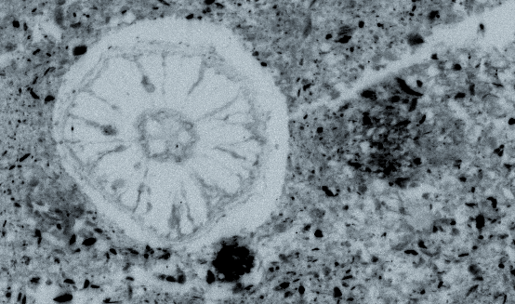
Rhizofiltration
Example… to not follow
Slag heap
Slag heap
6.5 Mt/yr => 160 Mt total
Micro X-ray fluorescence
Cu
Rice root
Fe oxides
Cu is associated with Fe and Mn (oxyhydr)oxides, clays, detrital organic matter, and roots.
Mn oxides
(phyllomanganates)
0.6 mm
Notes:
Cu is everywhere, associated with almost all organic and inorganic constituants. Other techniques can be used to characterized the TMs speciation => micro-XRD, micro-EXAFS. One example detailed below.

Slide 18
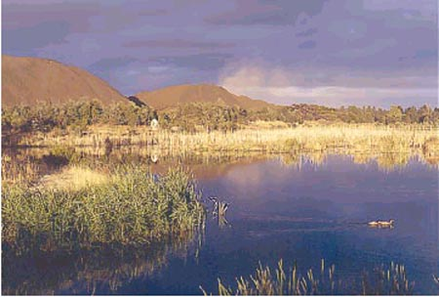
Rhizofiltration
Example… to not follow
Slag heap
Slag heap
6.5 Mt/yr => 160 Mt total
… to follow
Constructed wetland
Increase of pH by microorganisms and root activity, and possibly with carbonate amendments.
Organic-rich substrate which fixes TMs.
Wetland sediments are generally anaerobic below a thin oxidized surface layer.
Marchand et al., Environ. Pollution, 2010.

Slide 19
Phytotechnologies
  Phytoextraction
  Phytovolatilization
  Phytostabilization
  Rhizofiltration
  Phytolixiviation

Slide 20
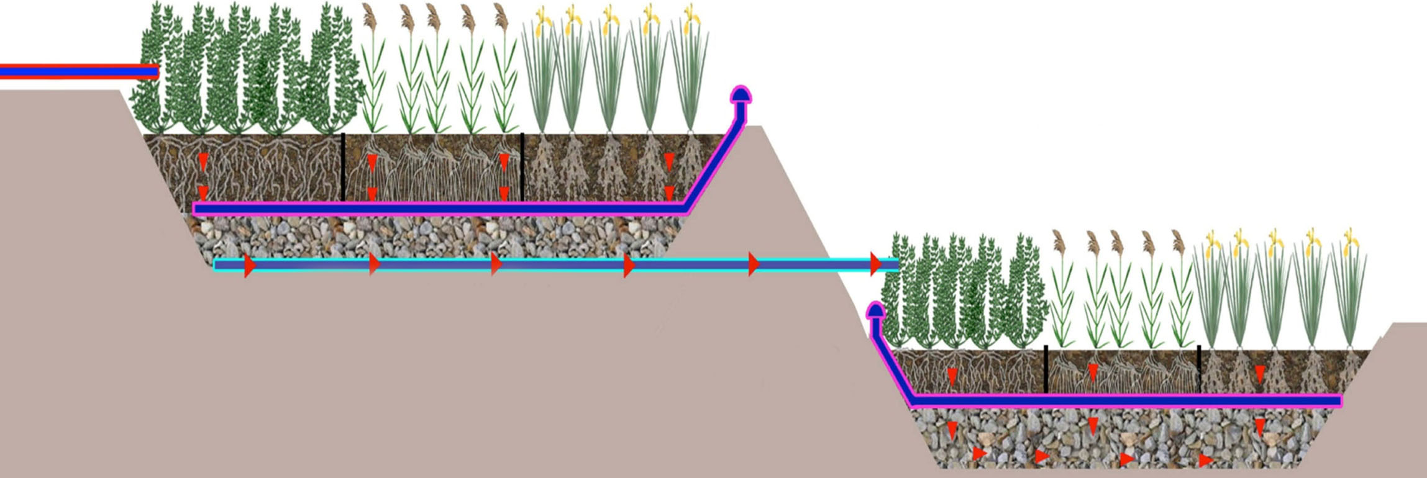
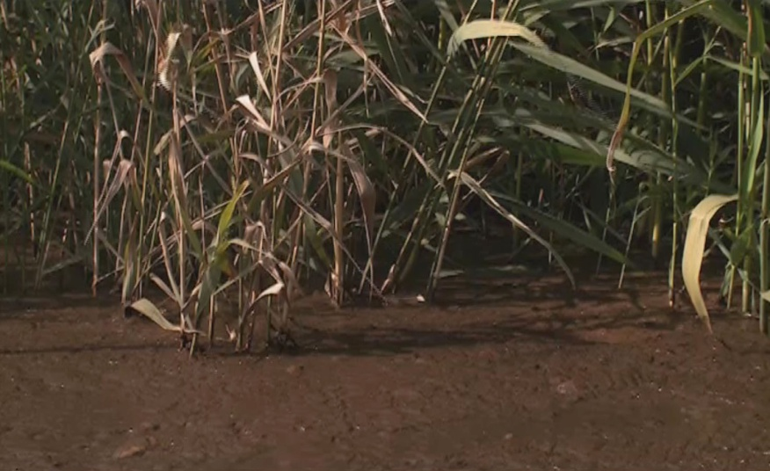
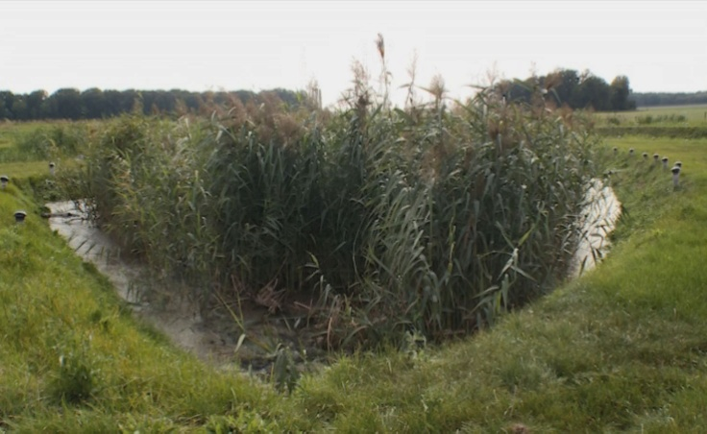
Phytolixiviation
Principle :
2-step process. Removal of TMs by lixiviation and Retention by adsorption/precipitation. Ex situ treatment.
Application :
Industrial and sewage sludge, soils and sediments in urbanized areas.
Phytolixiviation basin
Retention basin
Phytorestore’s filter gardens
http://www.phytorestore.com

Slide 21
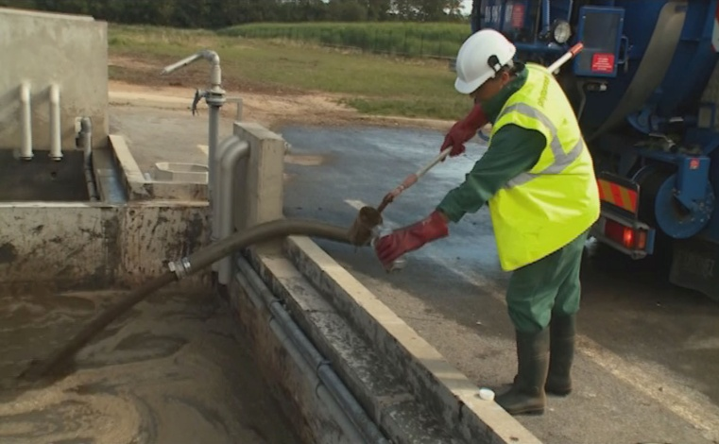
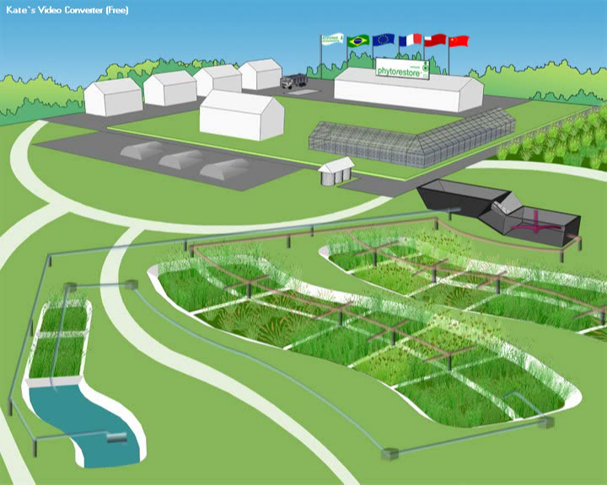
Phytolixiviation
Principle
Biofarm at Montereau, France
Phytolixiviation basins
Retention basin
Credit: http://www.phytorestore.com
Notes:
Trucks unload the waste to be treated. The sludge is homogeneized. Treatment pots are floaded, and the lixiviates collected and purified in the retention basin, then re-injected into the circulating system in a closed-loop.

Slide 22
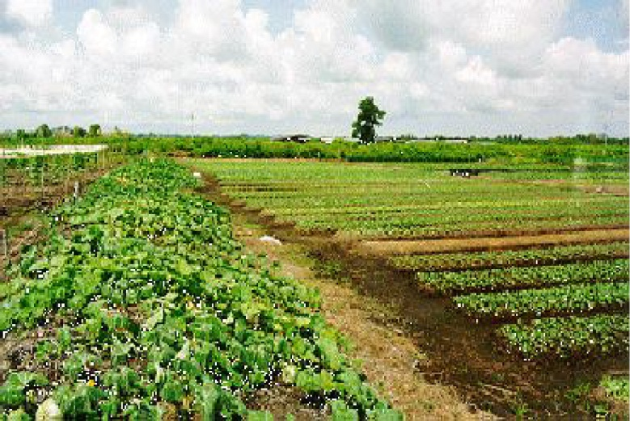
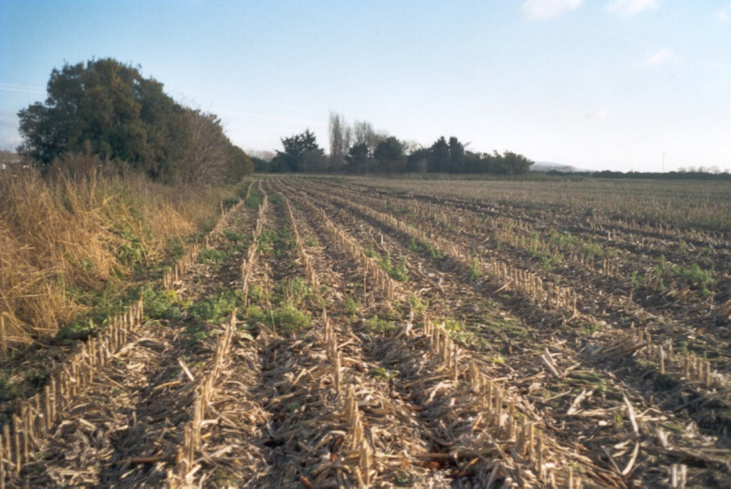
Application :
Speciation of Zn and Cu in a land irrigated for 100 yrs. with Paris wastewater
Area: 1500 ha
Heavy metal concentration:
mg kg⁻¹
Zn
Cu
Pb
150 - 3150
~ 350
~ 700
Until 1999…
Since 1999…
Truck farming activities
Only corn culture is permitted
Kirpichtchikova et al., GCA, 2006.
Notes:
The Pierrelaye plain is about 30 km northwest of Paris (France), in the heart of an urban industrial suburb. From 1899 to 1999, truck farmers irrigated the plain regularly with untreated sewage water from Paris. Now the entire area is contaminated with a suite of heavy metals, dominated by Zn (1,103 mg/kg), Pb (535 mg/kg) and Cu (290 mg/kg). This kind of pollution is widespread because as industry and populations increase, and the availability of freshwater decreases, more and more farmlands are irrigated with wastewater and industrial effluents.

Slide 23
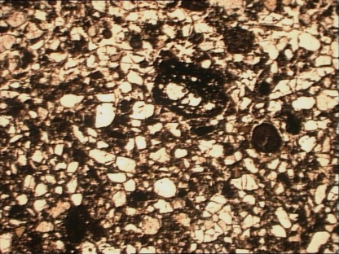
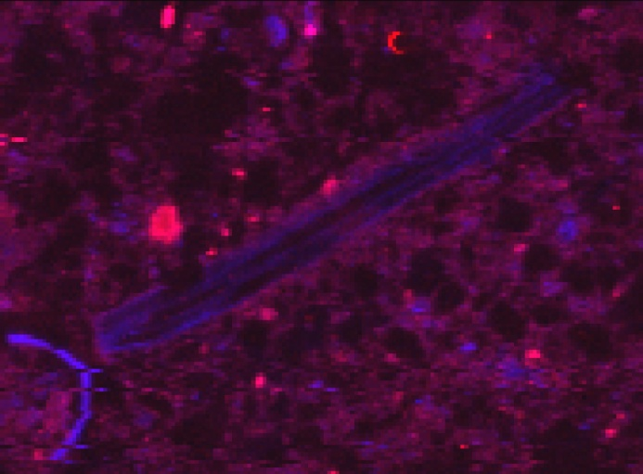
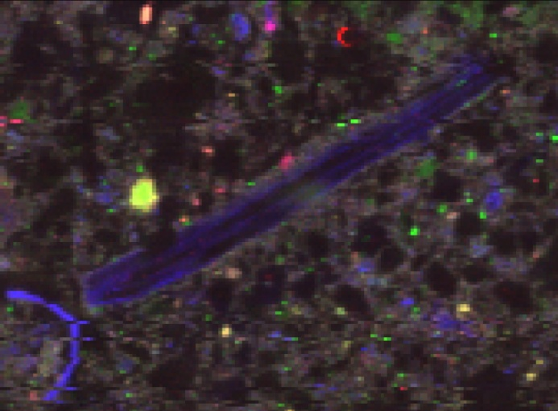
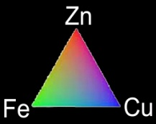
Micro X-ray fluorescence
Chemical Associations
Beam size: 5 x 5 μm
1 mm
Zn
Cu
500 µm
Notes:
Copper in the Pierrelaye soil is distributed between two morphological forms as seen in the XRF maps. Cu often decorates coarse organic particles with some recognizable structures from reticular tissue and also occurrs within the fine clayey matrix in areas that appeared featureless at low resolution, but showed organic particulate shapes at high resolution.
From chemical associations, at least two Cu species, one is organic + Zn-free, and the other is inorganic + Zn-bearing. One Zn species is common with Cu, and another is Fe-rich

Slide 24
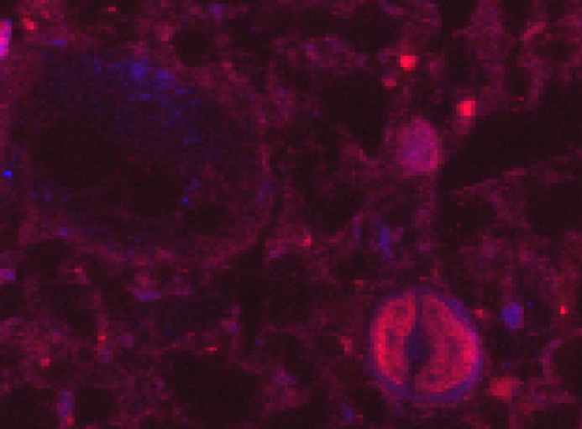
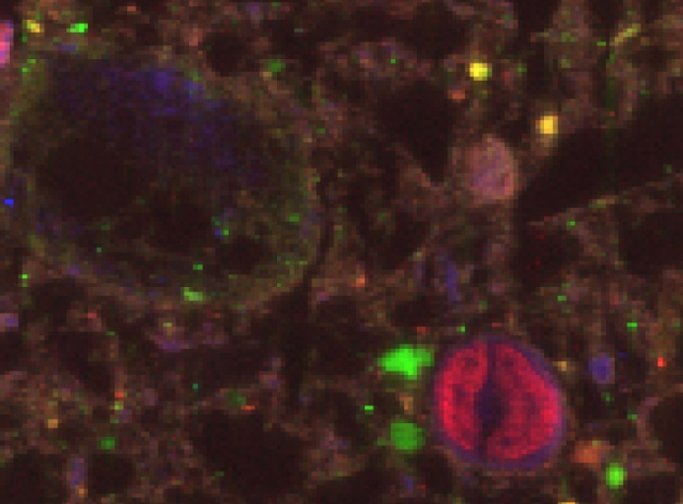
Micro X-ray fluorescence
Chemical Associations
Beam size: 5 x 5 μm
1 mm
Zn
Zn
Cu
Cu
500 µm
500 µm
300 µm

Slide 25
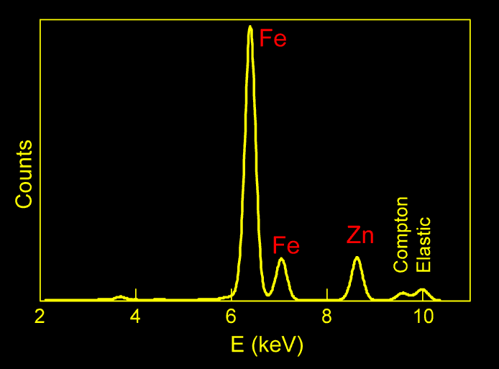
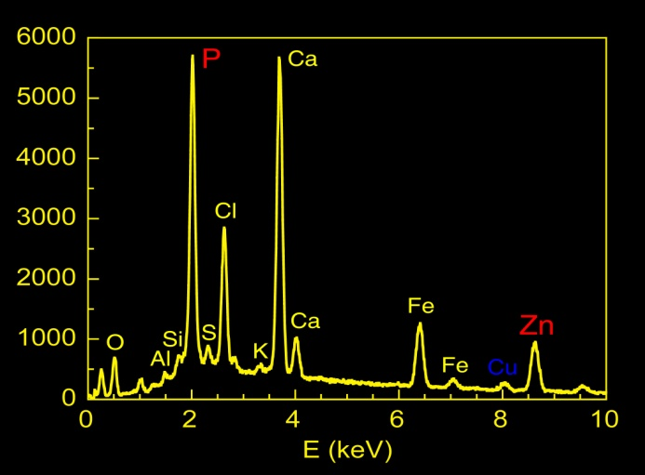

Micro X-ray fluorescence
Chemical Associations
Beam size: 5 x 5 μm
1 mm
Zn
Cu
500 µm
P
Zn
The Zn-Fe association likely corresponds to Zn-containing Fe (oxyhydr)oxide. What is its nature ?
Notes:
The Zn-P association likely corresponds to Zn-phosphate. The Zn-Fe association likely corresponds to Zn-containing Fe (oxyhydr)oxide. What is its nature? Response from micro-XRD.

Slide 26
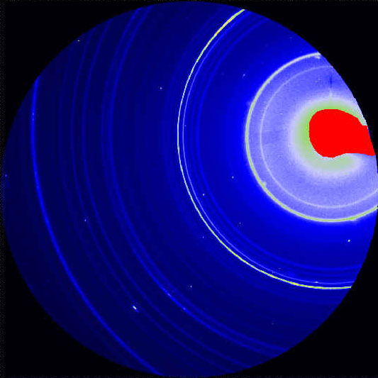

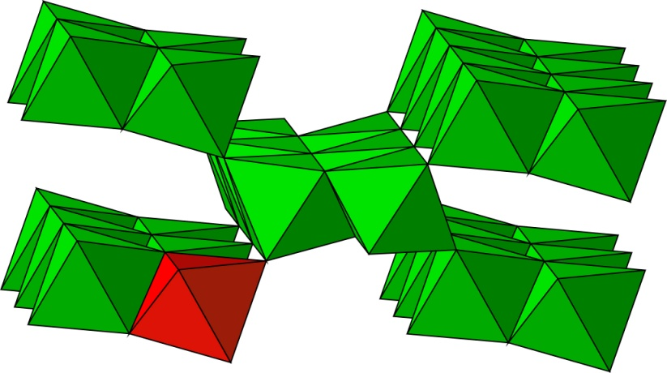
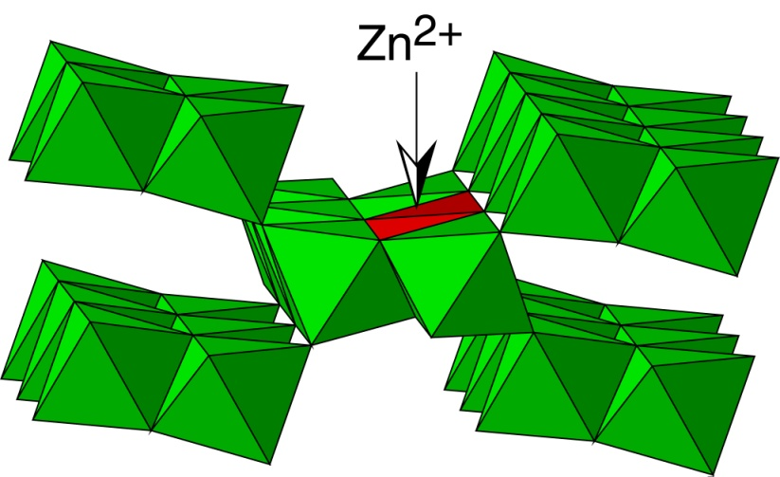
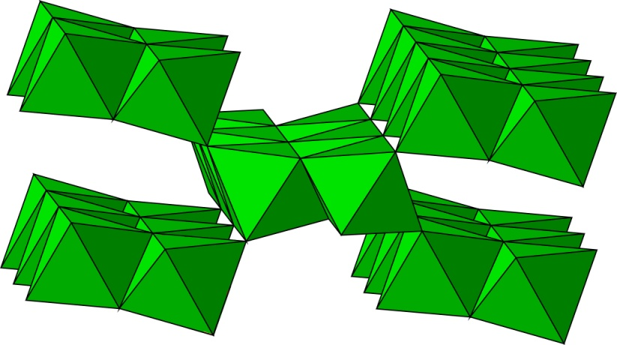
Micro X-ray diffraction
Identification of Mineral Species by μ-XRD
The answer comes from μ-XRD
300 µm
Goethite
(α-FeOOH)
Adsorbed Zn
Substituted Zn
Fe
Fe is speciated as goethite. Is Zn sorbed or incorporated into the goethite lattice?
Notes:
This information is essential to devise how to remove Zn. If Zn is a surface complex, then it can be desorbed by a stronger complexant using acid-base reactions. Citrate would do it. If Zn is buried inside the goethite lattice, then the only way to get it out is to dissolve the host matrix, typically by reducing Fe(III) to Fe(II). This can be achieved by alternating nonflooded and flooded irrigation to simulate periodic redox conditions expected during heavy rainfalls and favorable to the reduction of ferric iron to ferrous iron.

Slide 27
Structural Forms of Zn at the Molecular Scale
Micro EXAFS
The answer comes from Zn K-edge μ-EXAFS
100 % Zn-substituted goethite
α-(Fe,Zn)OOH
Zn
k³χ(k)
300 µm
k (Å⁻¹)
75 % Phyllosilicate +
26 % Goethite
61 % Phosphate +
38 % Willemite
k³χ(k)
k³χ(k)
R=0.39
R=0.35
k (Å⁻¹)
k (Å⁻¹)
What is the proportion of each Zn species in the bulk soil ?
Notes:
From visual comparison of elemental distributions on XRF maps, specific points-of-interest (POIs) are selected for micro-EXAFS measurements. Each point EXAFS spectrum ideally is from a pure Zn species identified from a spectral database. Otherwise, the nature and proportion of each Zn species in the mixture are determined from the reconstruction of the measured spectrum with a linear combination of reference spectra. The spectrum from the yellow spot is statistically identical to the reference spectrum for Zn incorporated into the goethite structure.

Slide 28
Micro EXAFS
Proportion of each Zn Species in the Bulk
Zn
The answer comes from powder EXAFS
k³χ(k)
k³χ(k)
Bulk EXAFS
k (Å⁻¹)
k (Å⁻¹)
Goethite
Phosphate
Phyllosilicate
Willemite
× … %
× … %
× … %
× … %
34 %
28 %
25 %
11 %
?
Precision :
±10 % of total Zn
Average Zn speciation
Zn is predominantly bound to secondary minerals.
Notes:
Bulk Zn-EXAFS represents a weighted sum of all contributions around Zn from the complex assemblage of all Zn species in the sample. The percentage of each Zn species in the bulk sample is obtained by performing a linear fit of the POIs spectra to the bulk EXAFS spectrum.

Slide 29
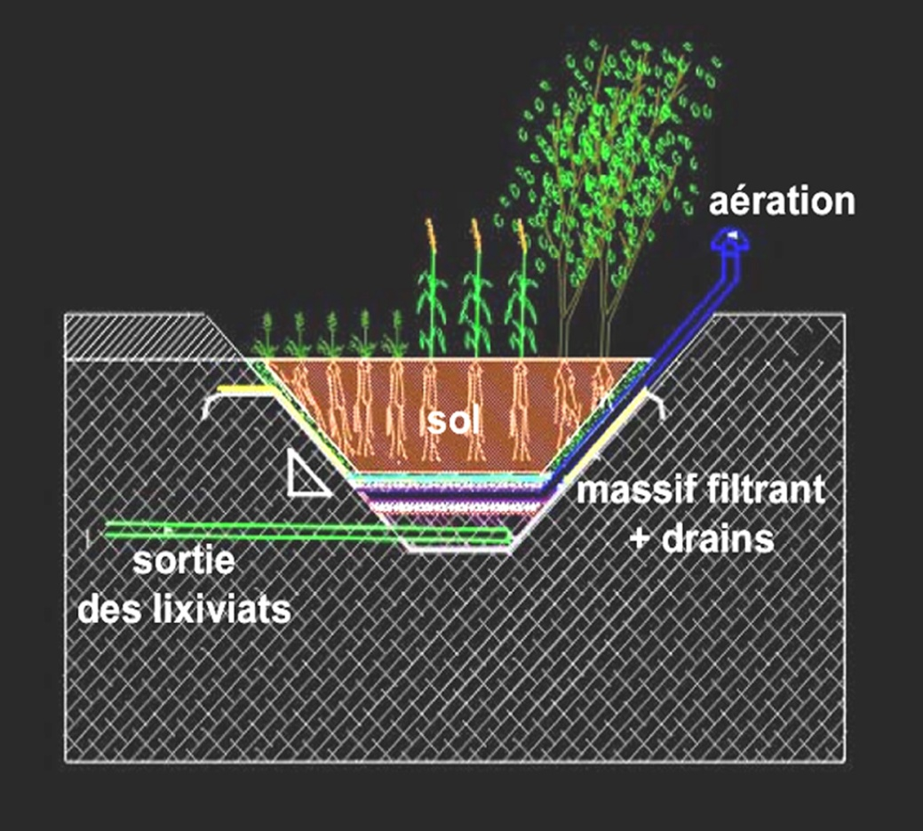
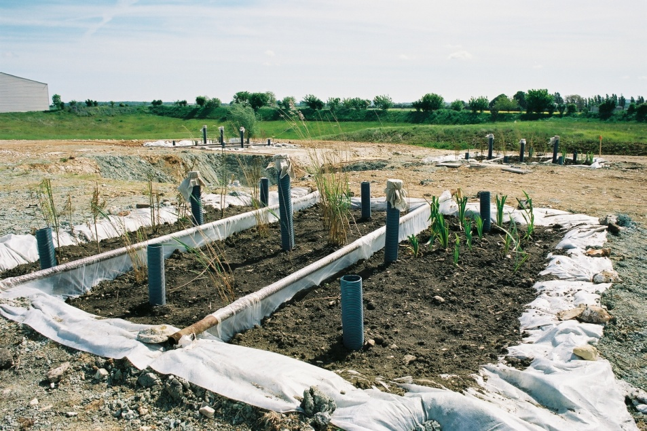
Phytolixiviation
Effects of chemical treatment and
rhizosphere activity on metal speciation
Objectives:
  To solubilize metals with natural organic acids (mostly citrate).
  To use plants to maintain the soil texture and to transform the residual fraction of metals into sparingly soluble forms.
Pilot site
Airduct
Soil
Porous substratum
Lixiviation outlet
Manceau et al., ES&T, 2008.
Notes:
The phytoremediation experiment was conducted from May 2002 to September 2003. Holes 4 x 4 m2 at the surface and 40 cm deep were dug in the ground, lined with a permeable membrane, and configured with basal drains to collect percolating irrigation waters. Soil aeration was achieved with a horizontal network of pipes at the depth of the liner connected to the surface by vertical pipes (capped to prevent ingress of precipitation) at 9 locations per pot. Pots were filled with soil from the Pierrelaye plain, and vegetated with Iris pseudoacorus and Phragmites australis. The pots were exposed to natural precipitation and also irrigated to dissolve the TMs.

Slide 30

Phytolixiviation
Effects of chemical treatment and
rhizosphere activity on metal speciation
Objectives:
  To solubilize metals with natural organic acids (mostly citrate).
  To use plants to maintain the soil texture and to transform the residual fraction of metals into sparingly soluble forms.
Pilot site
Airduct
Soil
Porous substratum
Lixiviation outlet

Slide 31

What is the form of metals after treatment ?
Accumulation
in shoot ?
Micronutrient Cu
Modification
of metal speciation in the rhizosphere
5 mg kg⁻¹ ≤ [Cu] ≤ 30 mg kg⁻¹ DW
Solubilization ?
Atomic fraction of metal exported (%)
Cu 0.03 %
Zn 0.01 %
Cu <1 %
Zn 38 %
Only a small fraction of Cu is lixiviated. Why?
Notes:
A large fraction of Zn was lixiviated, but not Cu, although it is phytotoxic. Why? The concentration of nutrient copper falls between 5 and 30 mg kg⁻¹ dry weight (DW) in vegetative tissues. When in excess, copper can catalyze the production of hydroxyl radicals, with subsequent damage to macromolecules involved in the production (chloroplasts) and storage (mitochondria) of energy, to protein synthesis, and to biomembranes through the peroxidation of unsaturated fatty acids. Because Cu is phytotoxic, how did the plants detoxify it to “deal with it”?

Slide 32



What is the form of metals after treatment ?
Rhizosphere of Phragmites
Cortex
Central cylinder (stele)
Phragmites australis
Zn Cu Ca
Resolution: 5 x 5 μm
endomycorrhizae
Epidermis
Endodermis
Aerenchyma
Most of Cu is located in the cortex of roots. What is its form ?
Manceau et al., ES&T, 2008.
Notes:
Micro-fluorescence map. Cu is located in the cortex, composed of parenchymatous cells. No Cu is present in the central vascular cylinder from the stele that contains the vascular bundles known to translocate micronutrients to reproductive and photosynthetic tissues. Cu is excluded in the roots to protect phytosynthetic and reproductive tissues from the shoot. How is it detoxified?
Many wetland species have porous roots (aerenchyma tissue) for the supply of oxygen for root respiration

Slide 33

The answer comes from μ-diffraction and μ-EXAFS
µ-EXAFS
Phragmites australis
k³χ(k)
Zn Cu Ca
Resolution: 5 x 5 μm
endomycorrhizae
Cu métallique
k (Å⁻¹)
µ-XRD
Cu is detoxified as copper metal.
Cu°
Notes:
Divalent Cu is detoxified as elemental Cu. By microorganisms or by the root physiological activity?

Slide 34


What is the form of metals after treatment ?
Rhizosphere of Iris
Iris pseudoacorus
Zn Cu Ca
Resolution: 8 x 8 μm
Micro X-ray fluorescence
ectomycorrhizae
Hypha
Optical image
Cu²⁺ is reduced to Cu° by symbiotic mycorrhizae.
Notes:
Response: Mycorrhizae do the job. The XRF map of the Iris rhizosphere is speckled with hot-spots of Cu grains ranging from about 5 to 20 microns in size The main roots and rhizome of iris do not contain detectable Cu grains, but in the surrounding soil Cu grains formed aligned features associated with Ca, suggesting a biological link. When viewed under an optical microscope the Cu spots occurred along the direction of filamentous and ramified organic structures, similar to root hairs or hyphae from ectomycorrhizal fungi. Fungal forms are more likely because mycorrhizal hyphae generally are anastamosing, whereas root hairs are not.
By analogy, Cu grains in the cortex of P. australis also may have been formed by mycorrhizae since the roots of this plant are colonized by arbuscular endomycorrhizae in contaminated soils and sediments.

Slide 35
Phytotechnologies
  Phytoextraction
  Phytovolatilization
  Phytostabilization
  Rhizofiltration
  Phytolixiviation

Slide 36



Phytoextraction
Principle :
To export TMs to the shoot.
Application :
Decontamination of soils and sediments. In situ treatment.
Metal hyperaccumulators
Ni
Alyssum bertolonii
> 1 % Nickel

Slide 37


Phytoextraction
Principle :
To export TMs to the shoot.
Application :
Decontamination of soils and sediments. In situ treatment.
> 1 % Zn et 0.1% Cd
Metal hyperaccumulators
> 1 % Selenium
~1 % As
Thlaspi caerulescens
Arabidopsis halleri
Astragalus bisulcatus
Pteris vittata

Slide 38


Phytoextraction
Example :
Zn hyperaccumulation and Cu tolerance in the Brassicaceae family.
Non-hyperaccumulator
Zn/Cd Hyperaccumulator
Zn-smelter ash
~2% Zn
Arabidopsis halleri
(Thlaspi caerulescens)
Arabidopsis thaliana
(Thlaspi arvense – Field pennycress)
Hyperaccumulation is metal-specific (no known Cu-hyperaccumulator), depends on the metal homeostasis.
Manceau et al., Am. J. Sci., 2000.
Notes:
Physiological control by the plant.

Slide 39
Phytoextraction
Example :
Zn hyperaccumulation and Cu tolerance in the Brassicaceae family.
Non-hyperaccumulator
Hyperaccumulator
Arabidopsis thaliana
Arabidopsis halleri
- Zn/Cd + Zn/Cd
- Zn/Cd + Zn/Cd
Credit: Dr. Emiko Harada
Notes:
Here experiment with Cd, but would work similarly with Zn.

Slide 40
Phytoextraction
Metal storage and speciation in below-ground tissues
Non-hyperaccumulator
[Zn]=200 ppm
T. arvense
[Cu]=15 ppm
Micronutrient
5 mg kg⁻¹ ≤ [Cu] ≤ 30 mg kg⁻¹ DW
Zn
[Zn]=265 ppm
Where and how are Zn and Cu stored ?
[Cu]=68 ppm
Cu

Slide 41


Phytoextraction
Metal storage and speciation
Non-hyperaccumulator
X-ray tomography
Zn stored in vacuoles as Zn-malate, and on cell walls as Zn-phosphate.
Cu stored on cell wall as Cu-histidine.
hair
stele
Xyleme
sap
cortex
T. arvense
200 μm
Beam size 70 x 80 nm²
Pixel size 180 x 180 nm²
Manceau et al. , Metallomics, 2013.
Notes:
X-ray tomography and nano-XRF images of Cu and Zn in a secondary root of Thlaspi arvense. Left. Image from the cortical tissue shows compartmentation of Cu on cell walls and Zn in vacuoles and on cell walls. Micro-XANES and micro-EXAFS show that the root restricts entry of Cu into the cytoplasm by chelation to histidine on the cell wall (next slide), and Zn by sequestration on the cell wall and within the vacuole. Pixel size: 0.18 (H) x 0.18 (V) micron². Right. Image from the stele with several protoxylem and metaxylem vessels with thickened walls encrusted with lignin. Cu and Zn occur on the cell wall and in the xylem lumen (with capture of the xylem sap). Pixel size: 0.2 (H) x 0.2 (V) micron².

Slide 42


Phytoextraction
Metal storage and speciation in below-ground tissues
bis(bidentate) chelate
Bidentate-tridentate chelate
bis(tridentate) chelate
pH ≤ ~4.5
~5 ≤ pH ≤ ~6
pH ≥ ~7
Hydrophobe chain
Strong chelate
Notes:
The L-histidine ligand changes orientation with pH. Micro-XANES and micro-EXAFS show that Cu is stored on cell walls as a unique five-coordinate Cu(II)–bis(L-histidinato) complex with one L-histidine behaving as a tridentate ligand and the other as a bidentate ligand. Tridentate binding of Cu(II) provides thermodynamic stability (similarly to Cu-citrate) needed to protect cells against copper toxicity, and bidentate binding enables kinetic lability along the cell wall through protein-protein docking with the non-bonded imidazole group (hydrophobic chain providing an anchor to proteins through van der Waals interactions).

Slide 43
Phytoextraction
Metal storage and speciation
Non-hyperaccumulator
X-ray tomography
Zn stored in vacuoles as Zn-malate, and on cell walls as Zn-phosphate.
Cu stored on cell wall as Cu-histidine.
hair
stele
Xyleme
sap
cortex
T. arvense
200 μm
Beam size 70 x 80 nm²
Pixel size 180 x 180 nm²
Manceau et al. , Metallomics, 2013.

Slide 44



Phytoextraction
Metal homeostasis in above-ground tissues
Hyperaccumulator
Zn
K
Leaf of Arabidopsis halleri
A. halleri, leaf tissue
Zn-malate
Non-hyperaccumulator
A. lyrata, nerve
Zn-phosphate
Zn
K
Leaf of Arabidopsis lyrata
15x15 μm²
Tolerance: Zn bound to phosphate in nerves, likely on cell walls.
Hyperaccumulation: Zn-malate complex, likely in vacuoles.
Sarret et al., New Phytologist, 2009.
Notes:
Zn partitioning between the veins and the leaf tissue.

Slide 45

Phytoextraction
Metal storage and speciation in
plant tissues
Non-hyperaccumulator
Hyperaccumulator
Zn phosphate
Zn phosphate
Zn malate
A. halleri
[Zn]=~50 ppm
[Zn]=~1%
Zn phosphate
Zn malate
Zn
Zn
Tolerance to Zn: accumulation on cell walls and in vacuoles from cortical root cells.
Resistance to Zn: hyperaccumulation in vacuoles of leaf cells.
Notes:
Tolerance = exclusion of TMs from the shoot. Metals are sequestered on the root cell walls and sometimes (Zn, Cd) also in the root (cortical) vacuoles. Hyperaccumulation: capacity of the plants to store Zn,Cd also in the leaf vacuoles.

Slide 46
Phytotechnologies
Cross-disciplinary field:
Agronomy
Soil science
Bio(geo)chemistry
Environmental mineralogy
Plant biology
Plant genetics
  Phytoextraction
  Phytovolatilization
  Phytostabilization
  Rhizofiltration
  Phytolixiviation

Slide 47



Phytovolatisation
Example :
Transpiration of Hg(0) by phytovolitalization.
Demethylation of Hg
operon
O
N
C-H
S
CH₃
Hg
MerB
MerA
Barkay et al., FEMS Micobiol. Rev., 2003.
Notes:
merB gene codes for the MerB lyase; merA gene codes for the MerA mercuric reductase.

Slide 48

Phytovolatisation
Integration of the merA and merB operons into the chloroplast genome.
Standard
merA/merB
Hg as phenylmercuric acetate
Ruiz et al. Plant Physiol., 2003.
Notes:
In plants, the primary target of Hg damage is the chloroplast; Hg inhibits electron transport and photosynthesis. The operon coding for mercuric ion reductase (merA) and organomercurial lyase (merB) is inserted into the chloroplast genome to prevent the pollen transmission of foreign DNA. The use of chloroplast (or mitochondrial) transformation to enhance phytoextraction/phytovolatisation is particularly beneficial because it prevents the escape of transgenes via pollen to related weeds.

Slide 49

Conclusion
1- The phytotechnology employed depends on the nature of the trace metal, the material to be treated, and its future usage.
Credit: Dr. T. Kirpichtchikova

Slide 50
Conclusion
2- Regulations are important because the « technology remedy » attenuates and rarely solves the problem completely.
Credit: Dr. T. Kirpichtchikova

Slide 51
Conclusion
3- Importance of Education.
Credit: Dr. T. Kirpichtchikova
Thank you!
Notes:
Importance of recycling to minimize waste.

